Slide 1
Case study title
Abhishek sharma

Slide 2
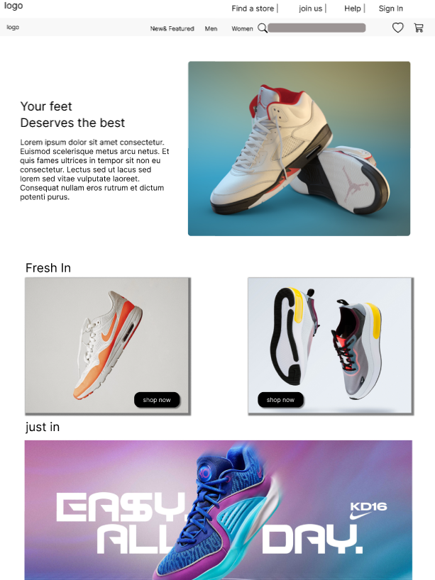
Project overview
The product:
This project is focused on providing good shopping experience.
Project duration:
It took 1week to design the website.

Slide 3
Project overview
The problem:
Difficulty if finding the right pair of shoes.
The goal:
Provide hastle free shopping.
Provide simple and user friendly app.

Slide 4
Project overview
My role:
Ux designer
Responsibilities:
Wireframing , prototyping, product

Slide 5
User research
Pain point
Personas
Understanding
the user

Slide 6
User research: summary
I conducted interviews and created empathy maps to understand the users I’m designing for and their needs. A primary user group identified through research was all age people who finds
Difficulty in going to shop and buy shoes.
Unmoderated research study is conduced and assumed that user can navigate between different tabs easily.

Slide 7
User research: pain points
1
2
3
Pain point
Pain point
Pain point
Difficulty in finding confirmation option.
Details of the product.
Navigation to Home screen.

Slide 8
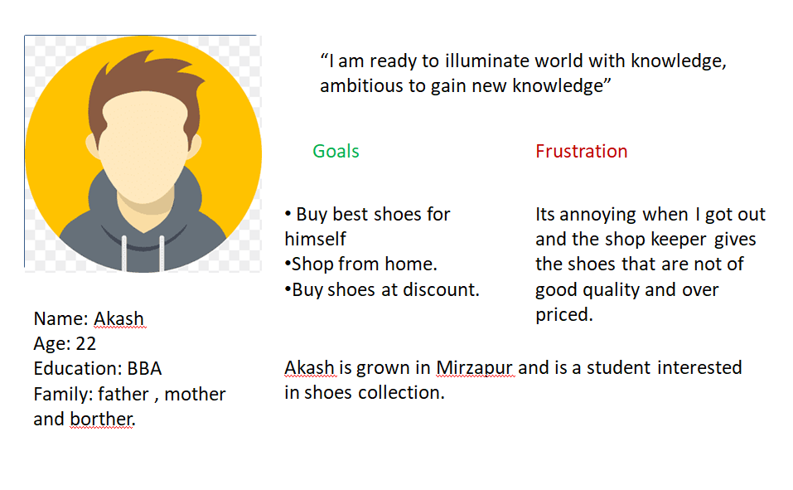
Persona: Akash
Problem statement:
Akash is a student and I really interested in fashion and want an website which can help him to buy best qulaoty shoes online.

Slide 9
Digital wireframes
Low-fidelity prototype
Starting
the design

Slide 10
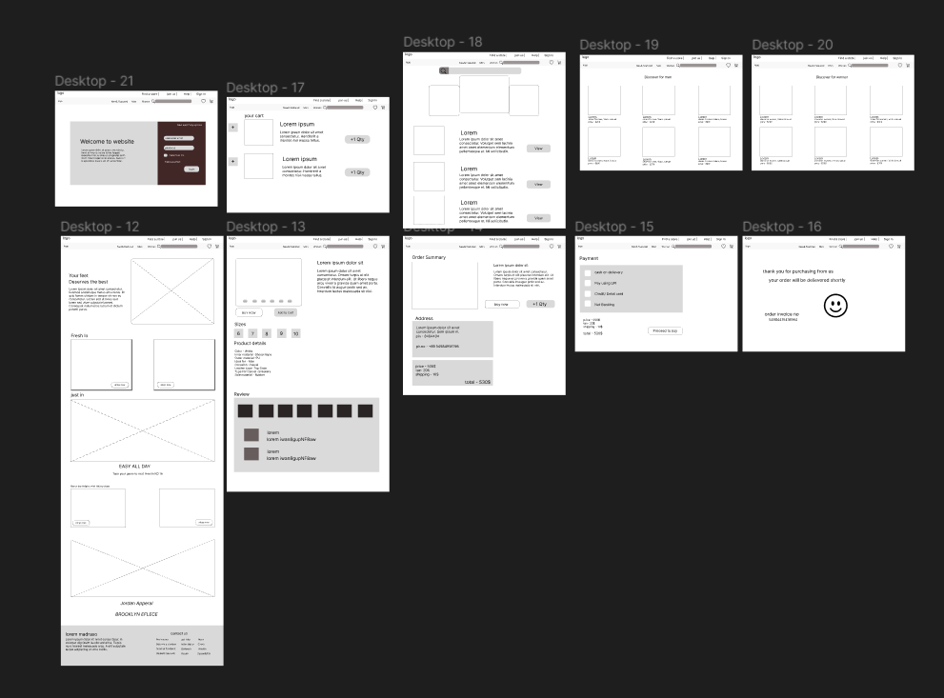
Digital wireframes

Slide 11
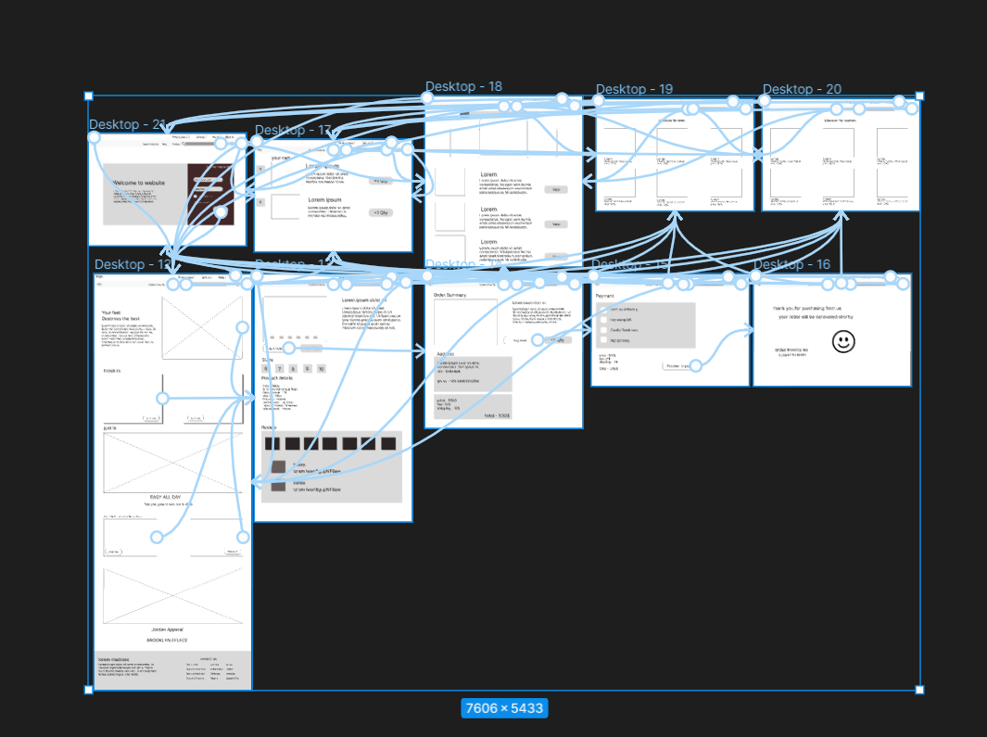
Low-fidelity prototype

Slide 12
Refining
the design
Mockups
High-fidelity prototype
Accessibility

Slide 13
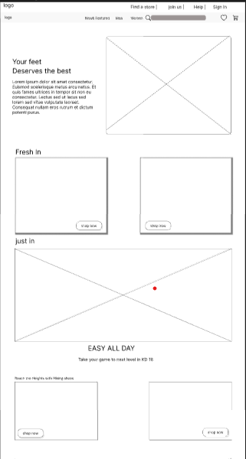
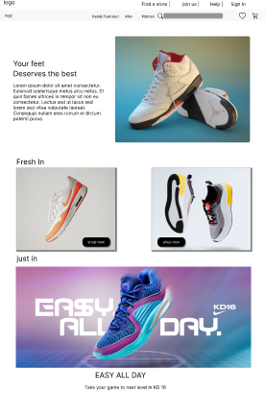
Before usability study
After usability study
Mockups

Slide 14
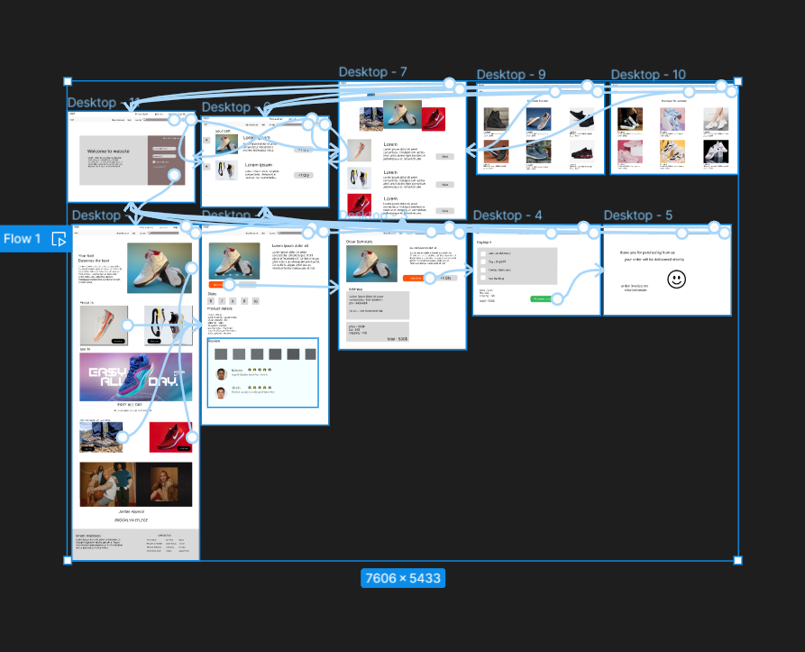
High-fidelity prototype
Screenshot of prototype with connections or prototype GIF

Slide 15
Accessibility considerations
1
2
3
Provided access to users who are vision impaired through adding alt text to images for screen readers.
Used icons to help make navigation easier.
Used image of shoes to help identify the product.

Slide 16
Going forward
Takeaways

Slide 17
Takeaways
Impact:
Helps the people to buy best qulatiy shoes for themselves without going out.
While designing the shoe-store , I learned that the first ideas for the app are only the beginning of the process. Usability studies and peer feedback influenced each iteration of the app’s designs.

Slide 18
Let’s connect!
Thank you for your time reviewing my work on the Shore-store! If you’d like to see more or get in touch, my contact information is provided below.
Email: abhisheksh0012@gmail.com

Slide 19
Thank you!

